Slide 1
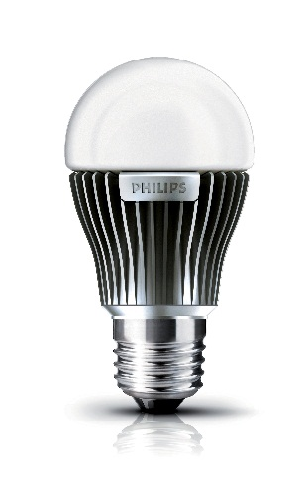

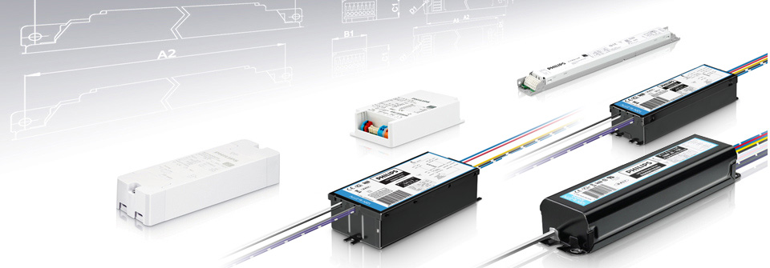

ARM Cortex M0+ Code Optimization
Author: Lyubomir Atanasov

Slide 2
Presentation Structure:
Project Introduction
Lighting Technology evolution
LED drivers
Microcontroller(the brain of a led driver)
Semiconductor Industry evolution
Project Execution & Results
Code Density Introduction
Optimization Techniques & RSA applicability
DMA & Atmel EVSYS
Conclusion(s) & Recommendation(s)

Slide 3



Lighting Sources
Candles
Incandescent Luminaires
Fluorescent Luminaries
LED Luminaries

Slide 4

Intelligent Lighting

Slide 5
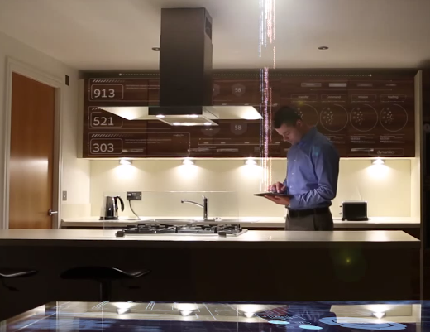




The evolution of Light

Slide 6

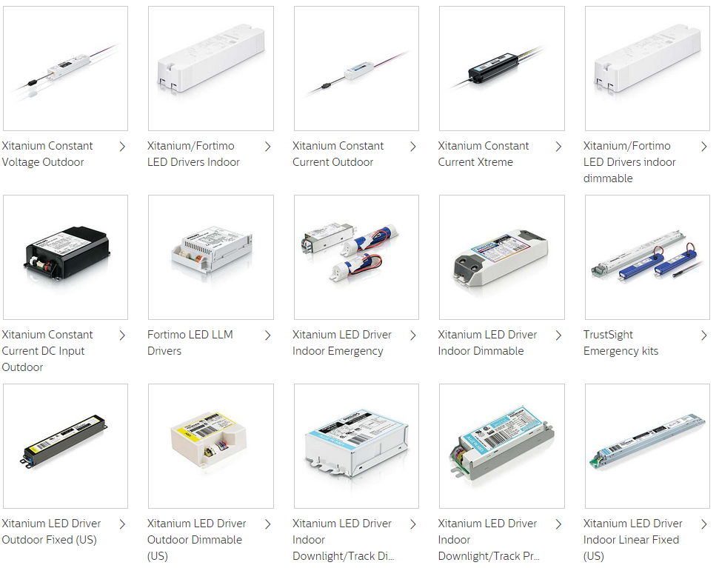
LED drivers
Regulates the power to a LED
Can implement software capabilities

Slide 7
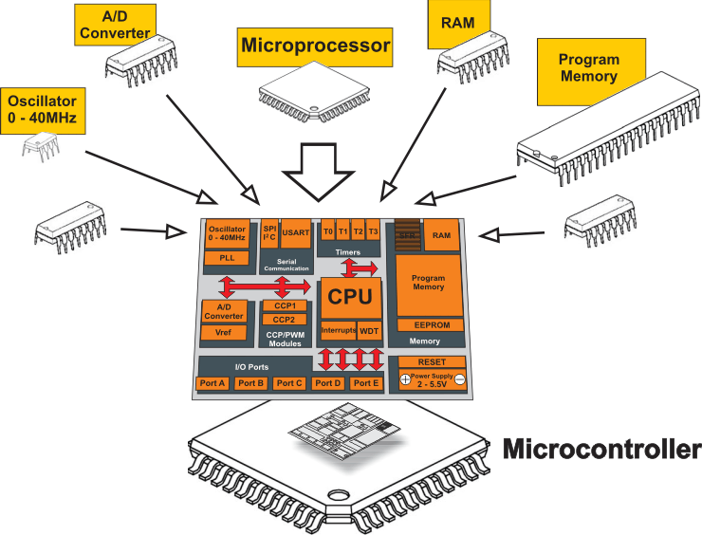
Microcontrollers
Small computer with limited capabilities
Typically has a processor, memory and peripherals

Slide 8
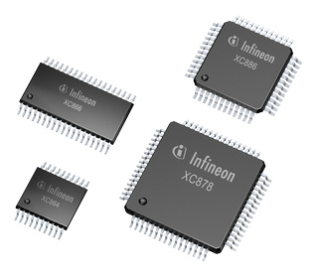
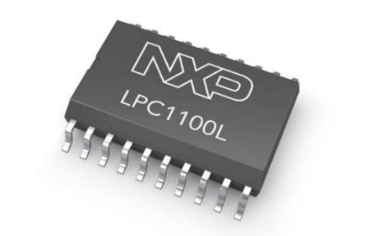
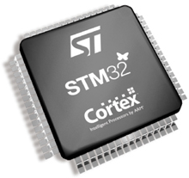
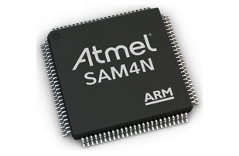
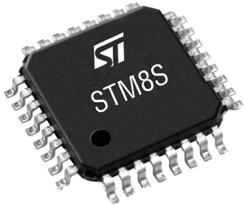
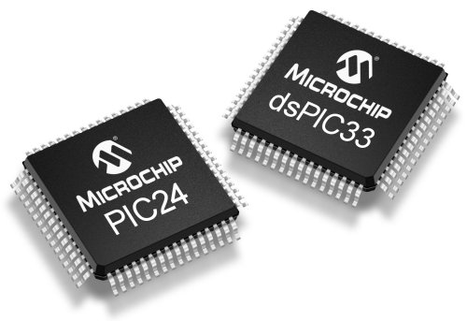
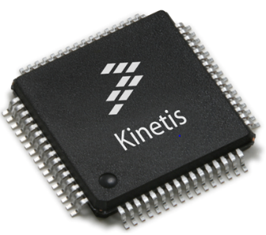
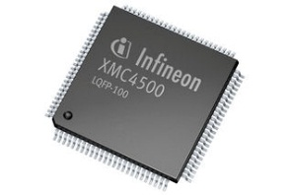

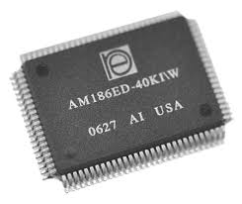
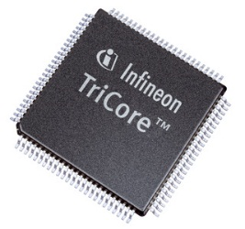
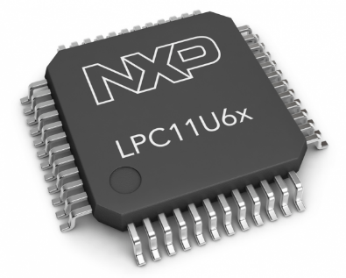
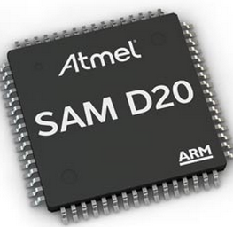

Microcontrollers Diversity
Categorize based on registers size

Slide 9
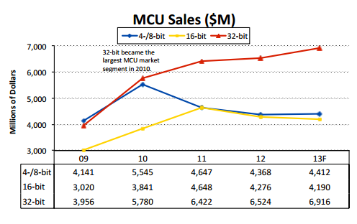
Rise of 32bit microcontrollers

Slide 10
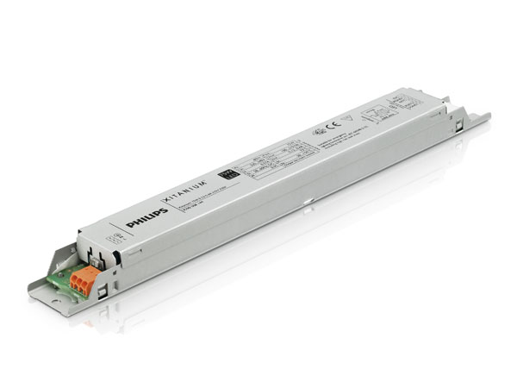
Switching to 32bit microcontrollers
Using 32bit microcontrollers for LED drivers
Code is optimal for a 8bit microcontroller
Switch to

Slide 11
ARM Cortex M0+ Code Optimization Assignment
Major Part – Code Density(size) Optimization | Minor Part – DMA & Atmel EVSYS
Investigate the factors which affect code density. Research the possible code density optimization techniques. Determine the applicability and impact of the techniques on the RSA. | Study DMAC. Study Atmel EVSYS. Determine an applicable case where DMA and EVSYS can be used. Create a Proof Of Concept (demo).

Slide 12
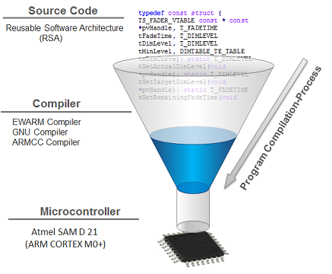
Code Density Introduction
What is code density ?
Is code density important ?
What affects code density ?
“the amount of space that an executable program takes up in memory”

Slide 13
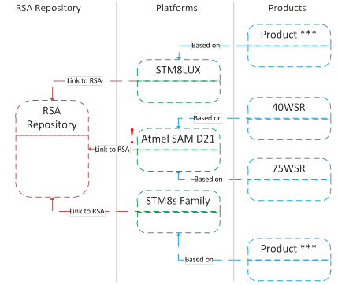
Reusable Software Architecture
Maintains common for LED drivers functionalities.
Foundation of multiple projects.
Initially optimized and developed for a 8bit microcontroller.

Slide 14
The Optimizing Compiler

Slide 15
Compilers Battle
Compiler | Best Code Size | Best Data Memory | Best Total Memory
ARMCC | 18988 | 3172 | 22160
EWARM | 20698 | 1502 | 22200
GNU | 22108 | 1460 | 23568

Slide 16
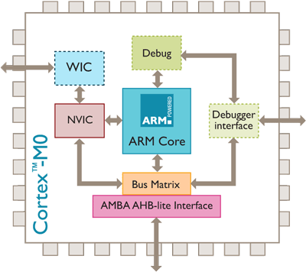
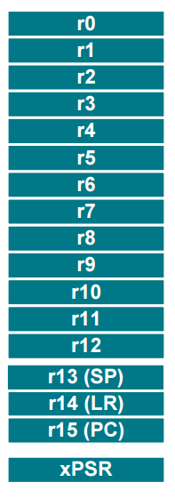
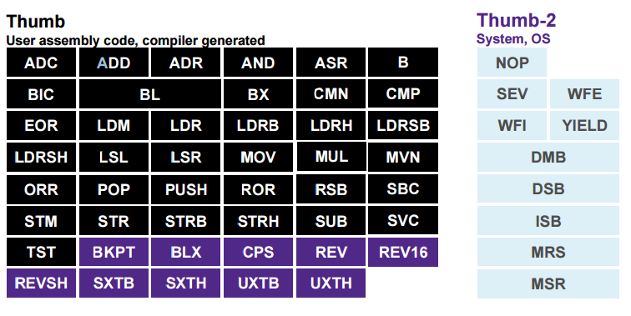
ARM Cortex M0+
Architecture
Registers
Memory Model
Instruction Set

Slide 17
Optimization Techniques
Structure padding
Spatial locality
Unaligned memory access
Function Registers allocation
Global Variables
Bit fields
Data Types

Slide 18
Structure Padding
Expected Layout | Actual Layout
typedef struct foo1 { int m2; /*takes 4 bytes*/ short int m1;/*takes 2 bytes*/ short int m3;/*takes 2 bytes*/ }foo1Struct; | typedef struct foo1 { int m2; /*takes 4 bytes*/ short int m1;/*takes 2 bytes*/ short int m3;/*takes 2 bytes*/ }foo1Struct;
Structure: | Potential reduction (bytes):
TS_TIMER | 4
TS_QUEUE | 2
TS_AUTO_BACKUP | 8
TS_DALIVARS | ?

Slide 19
Unaligned Data Access
Unaligned structure access C code | Unaligned structure access assembly
#pragma pack(push,1) struct foo1 { int num1; double num3; short int num2; }Structure; #pragma pack(pop) main() { struct foo1 alignedStrucutre={1,2,3}; int a= alignedStrucutre.num1; int b= alignedStrucutre.num2; int c = alignedStrucutre.num3; volatile int sum = a+b+c; } | PUSH {LR} SUB SP,SP,#+20 ADD R0,SP,#+4 Nop ADR.N R1,`?<Constant {1, (2.0), 3}>` MOVS R2,#+16 BL __aeabi_memcpy4 LDR R0,[SP, #+4] MOVS R1,#+12 ADD R2,SP,#+4 LDRSH R1,[R2, R1] LSLS R1,R1,#+1 ADDS R0,R0,R1 STR R0,[SP, #+0] MOVS R0,#+0 ADD SP,SP,#+20 POP {PC}
Structures in module: | Potential reduction (bytes):
dalislave_dc | 544
dalimb_dc | 0
submb | 156

Slide 20
Data Type Optimization
16bit variables c code | 16 bit variables assembly code
unsigned short int foo(unsigned short int a,unsigned short int b) { return a+b; } int main() { int res=foo(1,2); return res; } | foo: UXTH R0,R0 UXTH R1,R1 ADDS R0,R0,R1 BX LR main: PUSH {R7,LR} MOVS R1,#+2 MOVS R0,#+1 BL foo
Instruction: | Count: | Potential reduction (bytes):
UXTH | 47 | 94
UXTB | 109 | 218

Slide 21
Global Variables
Accessing global variables | Accessing global variables
int a; int main() { a =5; } | MOVS R0,#+5 LDR R1,??main_0 STR R0,[R1, #+0] MOVS R0,#+0
Module: | Potential reduction (bytes):
swdalidrv | 28

Slide 22
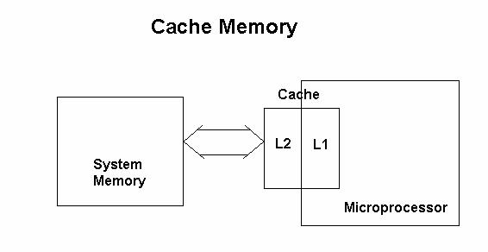
Cache Locality
Structure: | Potential reduction (bytes):
TS_DALIVARS | 68

Slide 23

Bitfields
Structure: | Potential reduction (bytes):
TS_CONFIG_INFO | 52

Slide 24
Final Results
Total reduction (bytes): | Total reduction (%)
1056 | 5.6

Slide 25
Director Memory Access
Data transfer between memory and peripherals
No CPU utilization
Can be triggered by Atmel EVSYS

Slide 26
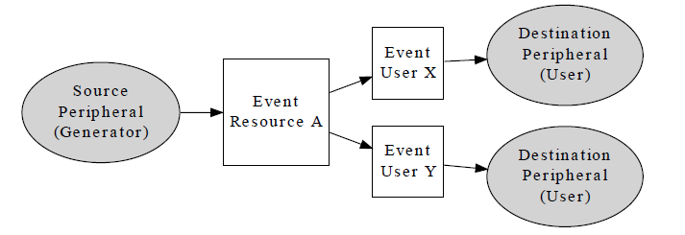
Atmel EVSYS
Peripherals can generate event signals
Atmel EVSYS can route signals between peripherals
Can be triggered by Atmel EVSYS

Slide 27
Using DMA & EVSYS
ADC Sampling without CPU utilization

Slide 28

Conclusion(s) & Recommendation(s)

Slide 29
The End
Thank you, for your attention !

